Slide 1
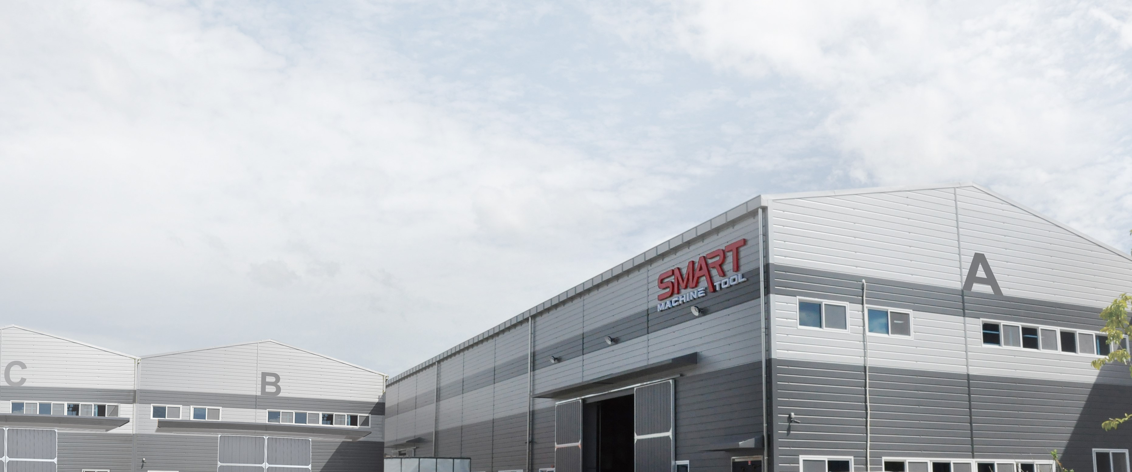
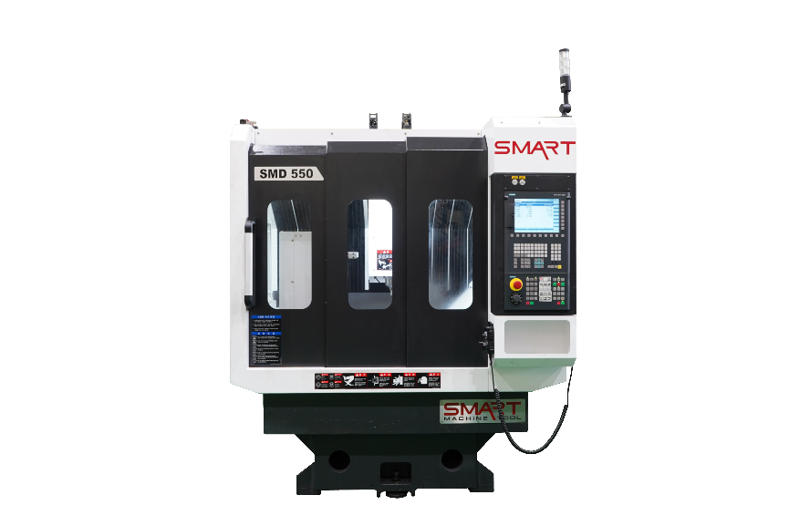
SMD 550
High Speed Drilling
Built Tough, Built SMART !

Slide 2
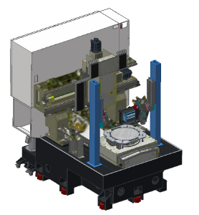

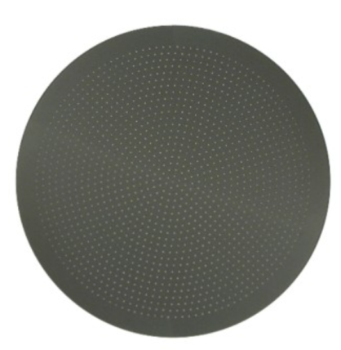
1. High Speed Drilling Center
Machine Specifications
DESCRIPTION |  |  | UNIT | SMD 550
FEED | Travel distance | X-axis | mm (inch) | 820 (32.28)
 |  | Y-axis | mm (inch) | 770 (30.31)
 |  | Z-axis | mm (inch) | 200 (7.87)
 | Rapid traverse rate | X-axis | m/min (ipm) | 30 (1,181)
 |  | Y-axis | m/min (ipm) | 30 (1,181)
 |  | Z-axis | m/min (ipm) | 15 (590.55)
 | spindle nose ~ table top |  | mm (inch) | 68 ~ 268(2.68~ 10.55)
 | Slide type |  | - | LM Guide(Ball Guide)
TABLE | Table size |  | mm (inch) | 500x570(19.69x22.44)
 | JIG & Fixture size |  | mm (inch) | Ø450 (17.72)
 | Clamp type |  | - | Air(3-point)
SPINDLE | Taper |  | - | HSK E25
 | Max. spindle speed |  | rpm | 40,000 Ball Bearing [Opt :50,000 Air Bearing]
 | Spindle output |  | kW(hp) | 2 (2.7) [3 (4.08)]
 | Max. spindle torque |  | N.m (ft.lbs) | 0.96 (0.71) [0.72 (0.53 )]
ATC | Tool storage capacity |  | Ea | 8
 | Tool-to-Tool |  | Sec | 5
MACHINE SIZE |  |  | mm (inch) | 1,792x2,187x2,350 (70.55x86.1x92.52)
CONTROLLER |  |  | - | Fanuc OimF 10.4” [Opt: SIEMENS 828]

Slide 3
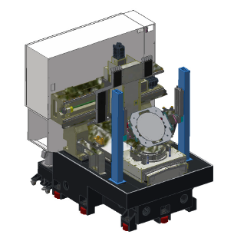
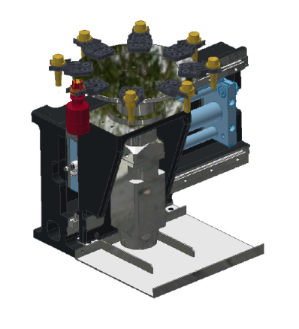
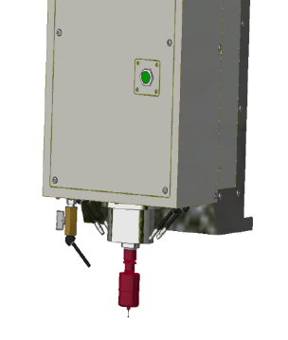
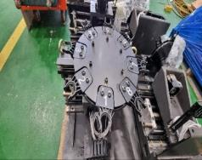
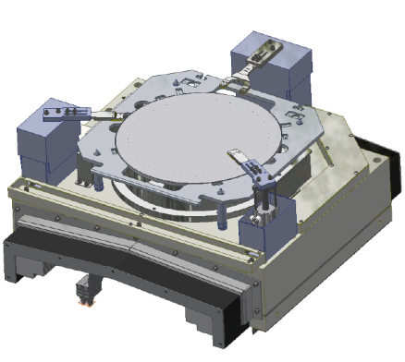
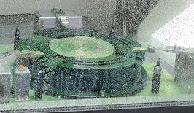
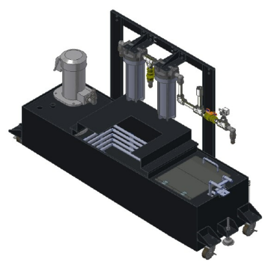
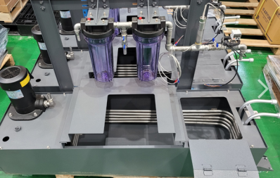
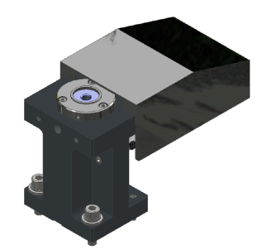
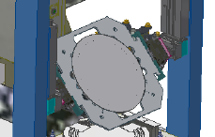
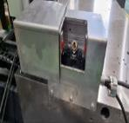
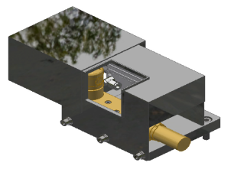
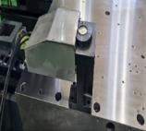
Specifications and features of each part of the machine
ATC Magazine 8ea
Spindle Spec
HSK-E25
40,000RPM
3KW
Fixture ø450
Air clamp type - OPTION
Coolant tank (oil cooling & filtering) - OPTION
Work Rotation (180˚) - OPTION
Tool measuring (Renishaw NC4) - OPTION
Work measuring (Ring gage) - OPTION

Slide 4
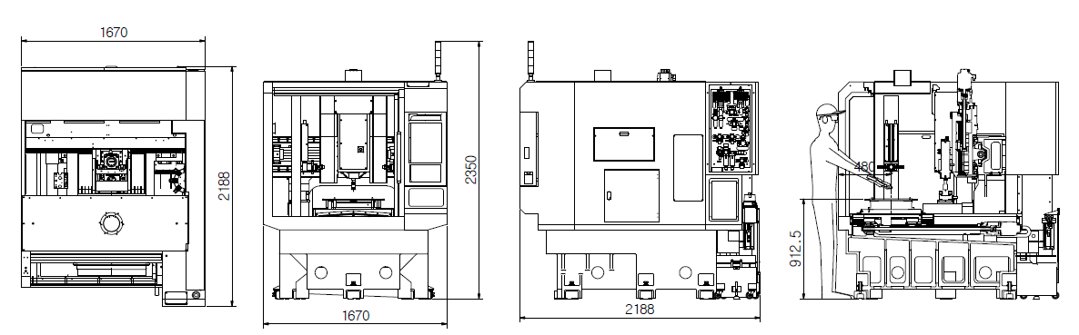
Lay-out
( ) : inch
DOOR OPEN
1,670(65.75)
1,100(43.3.75)
2,350(92.52)
480(18.9)
2,188(86.14)
815(32.08)
1,670(65.75)
2,188(86.14)
Height of table top surface : 815 (32.08)
- Height of jig top surface: 815 (32.08)(Adjustable)
Top view
Front view
Side view
Distance from table : 480 (18.9)

Slide 5
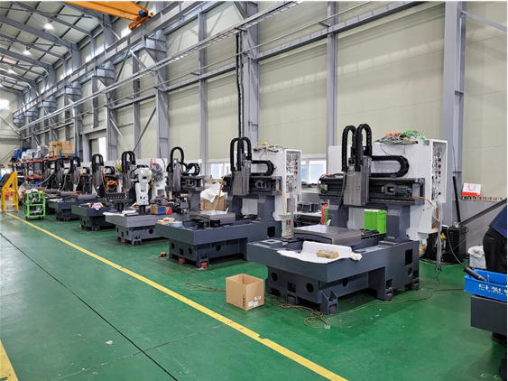
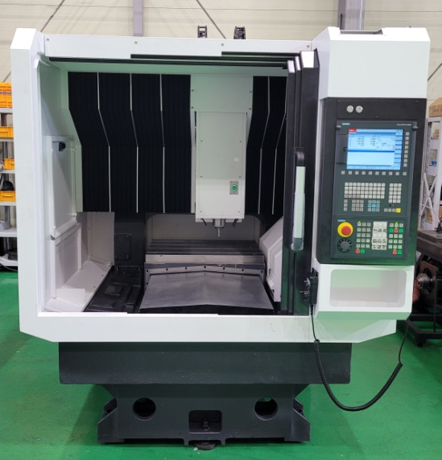
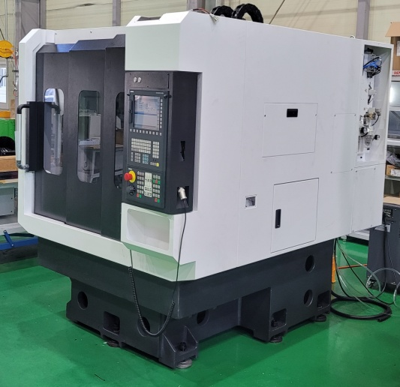
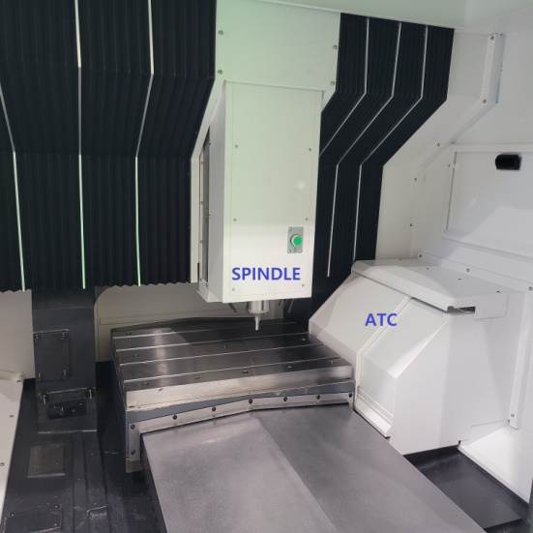
Production Line

